Slide 1
Accounting
Instructor Workflow

Slide 2
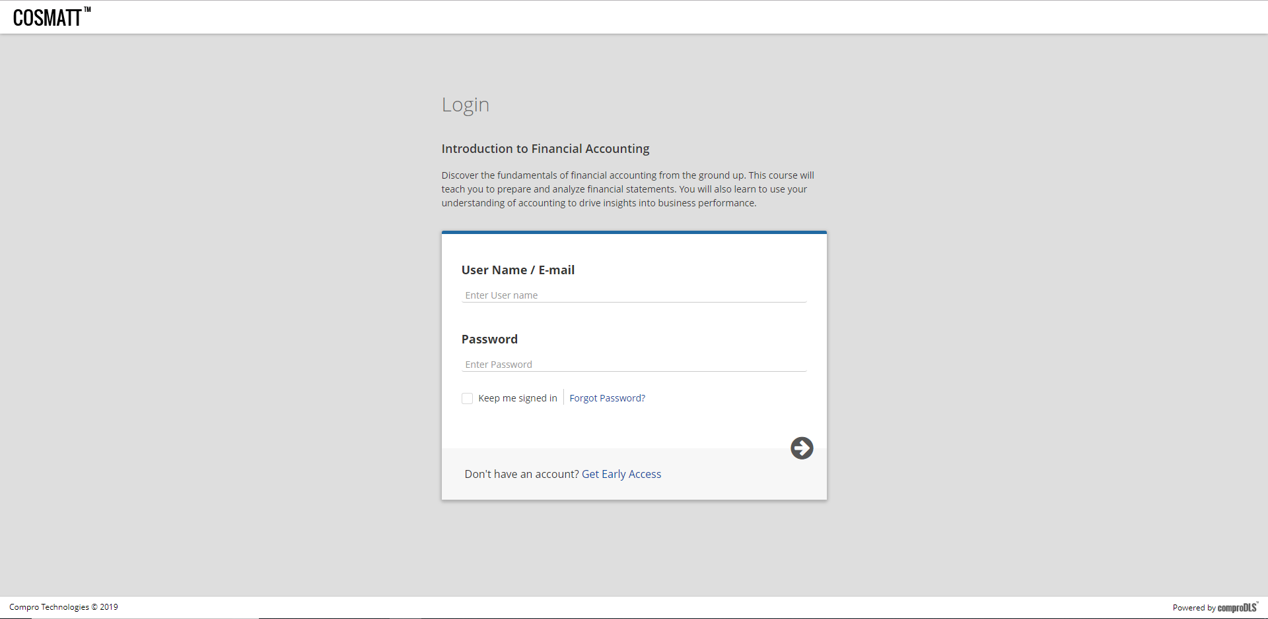
Login Page

Slide 3
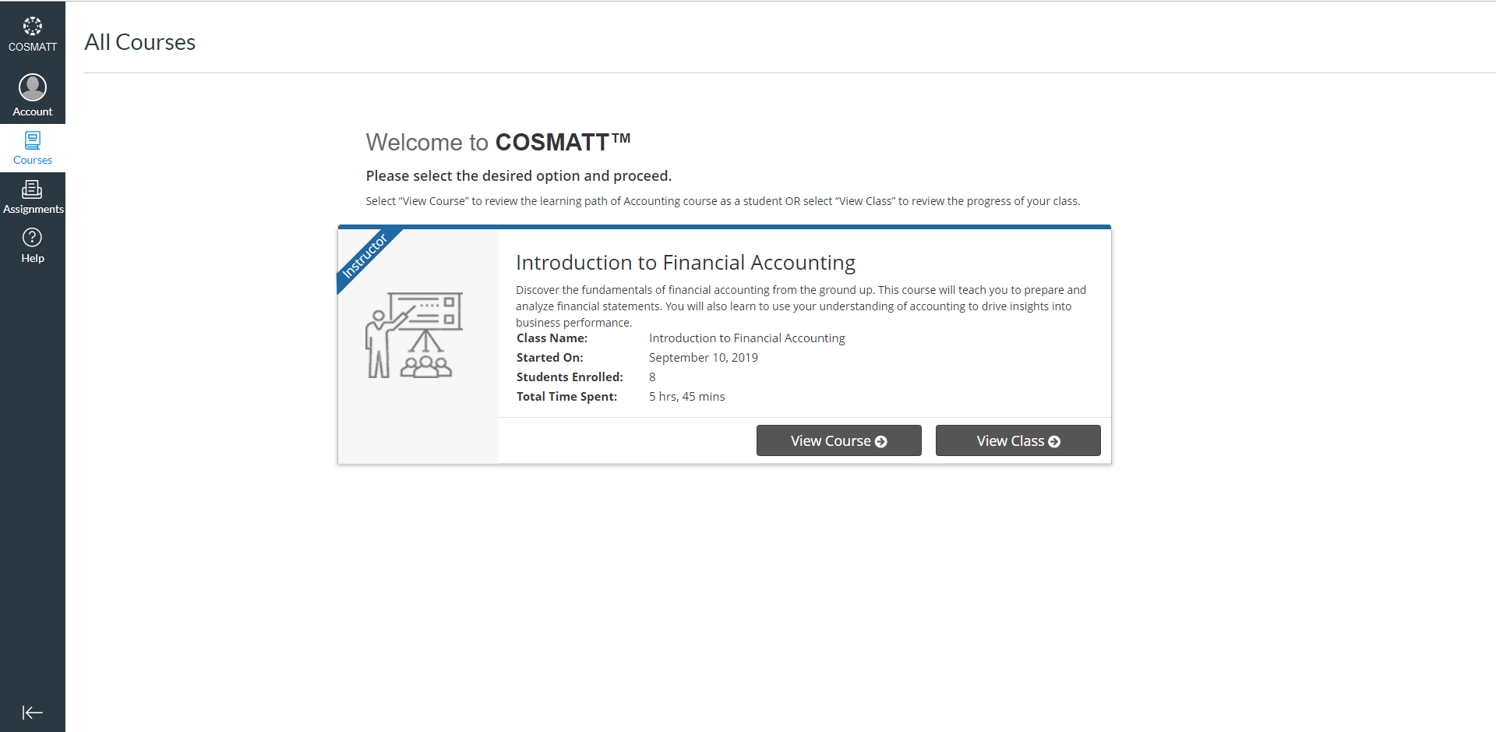
Instructor’s Home Page

Slide 4
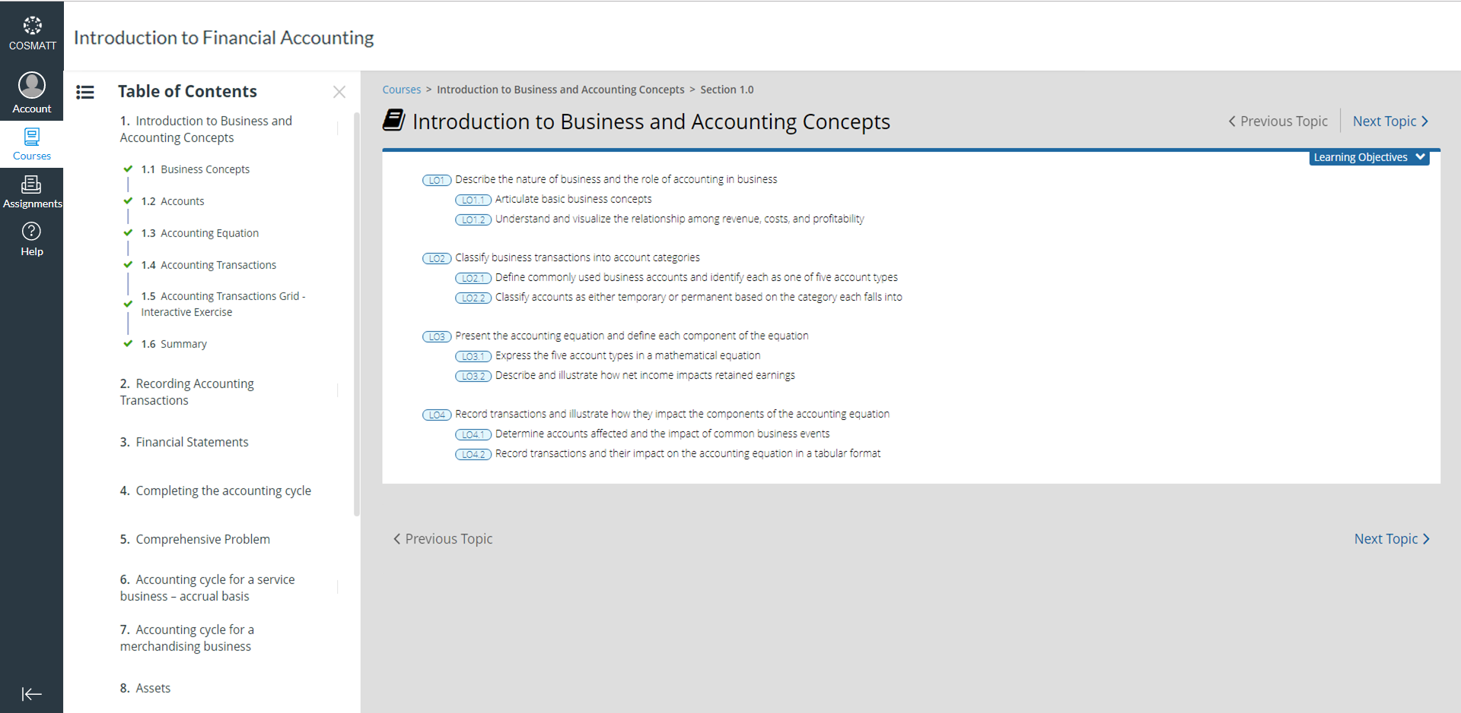
View Book Page

Slide 5
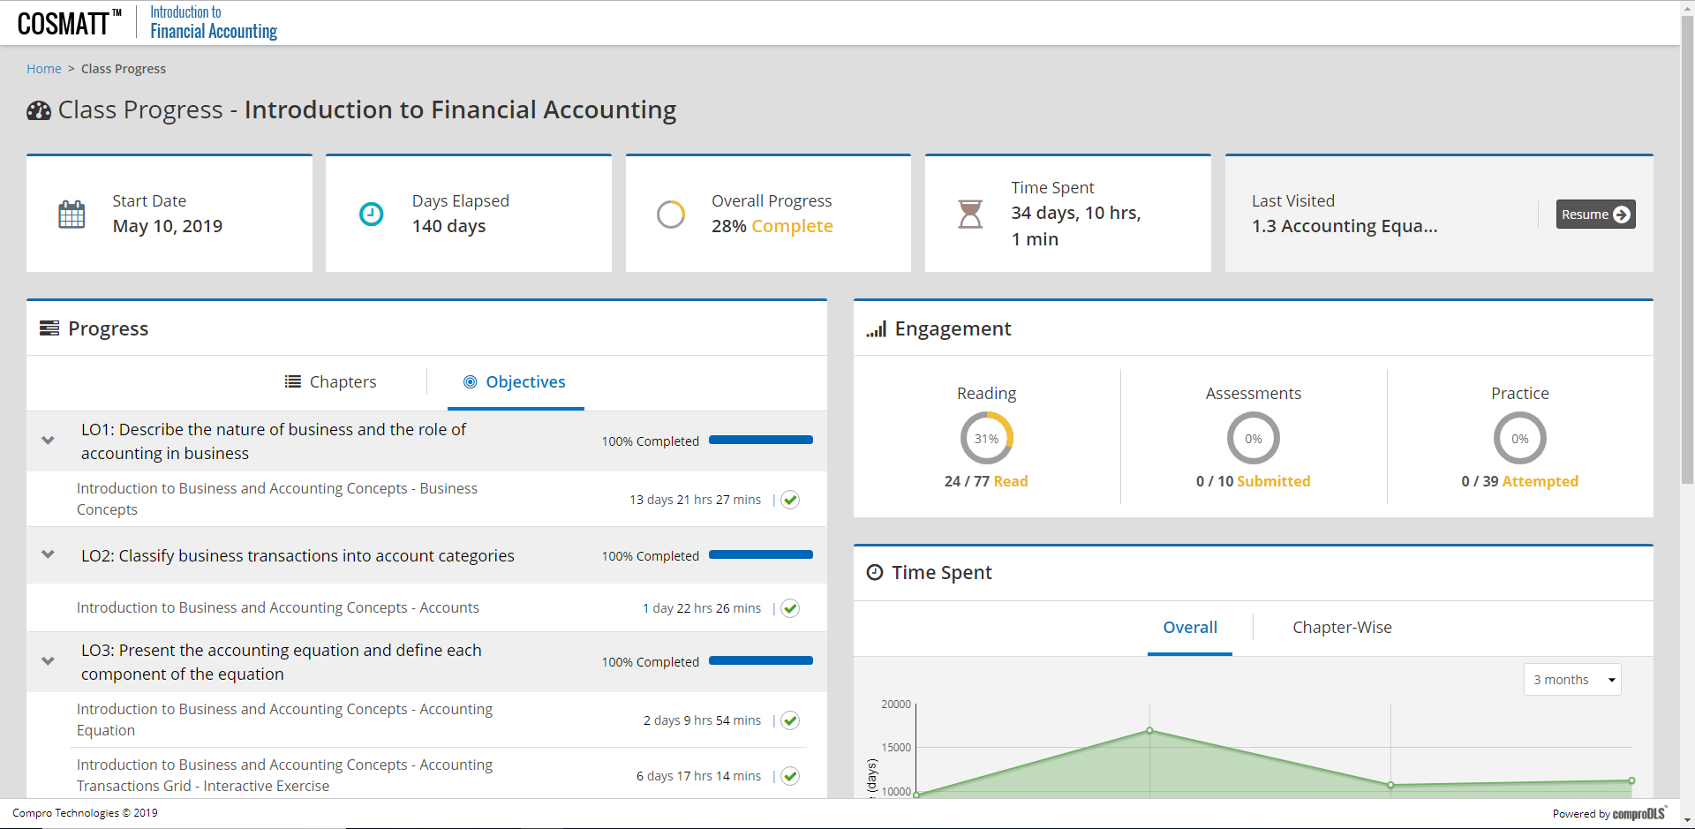
View Class Page

Slide 6
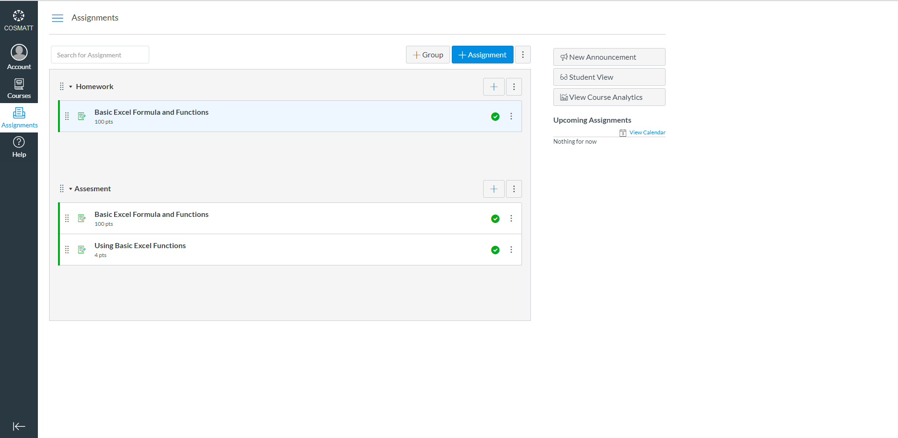
Assignments List Page

Slide 7
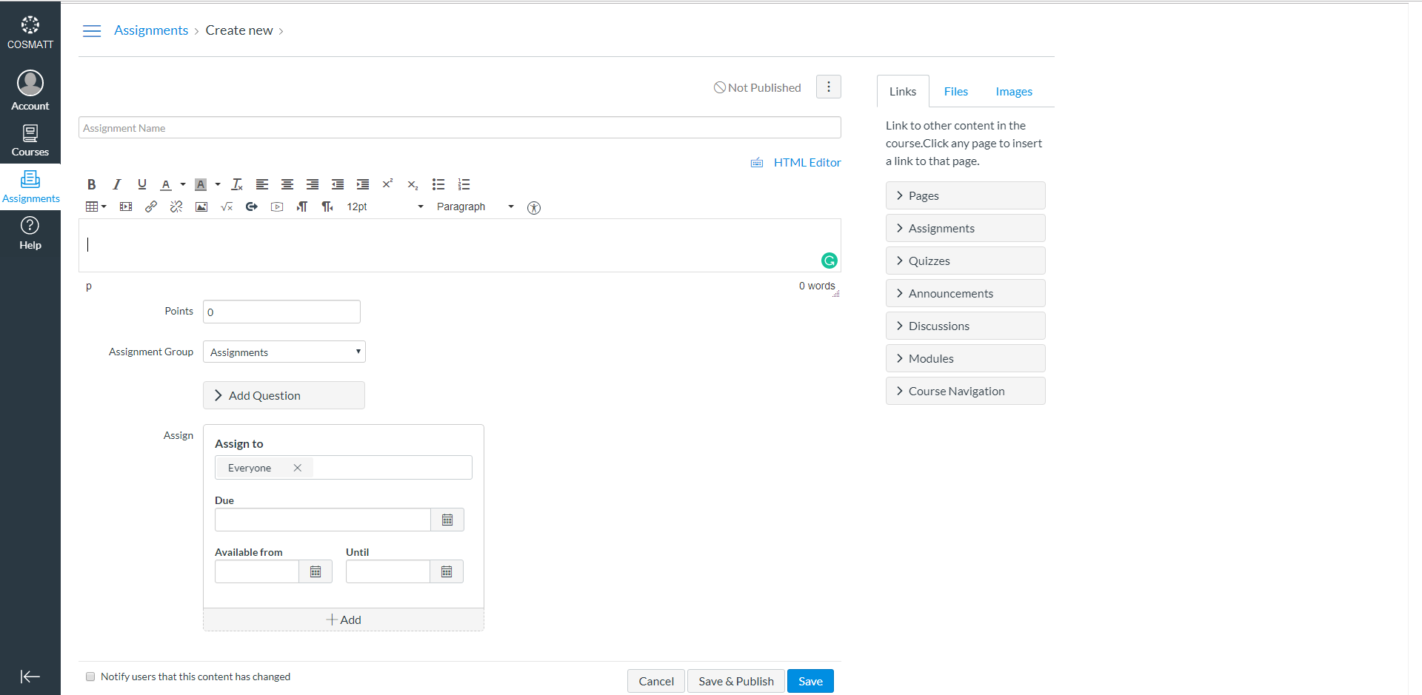
Create Assignments Page

Slide 8
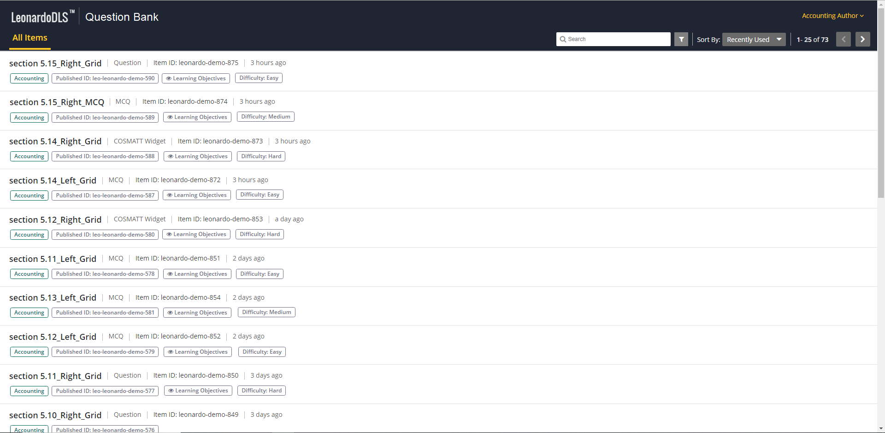
Question Bank Home Page

Slide 9

Question Options

Slide 10
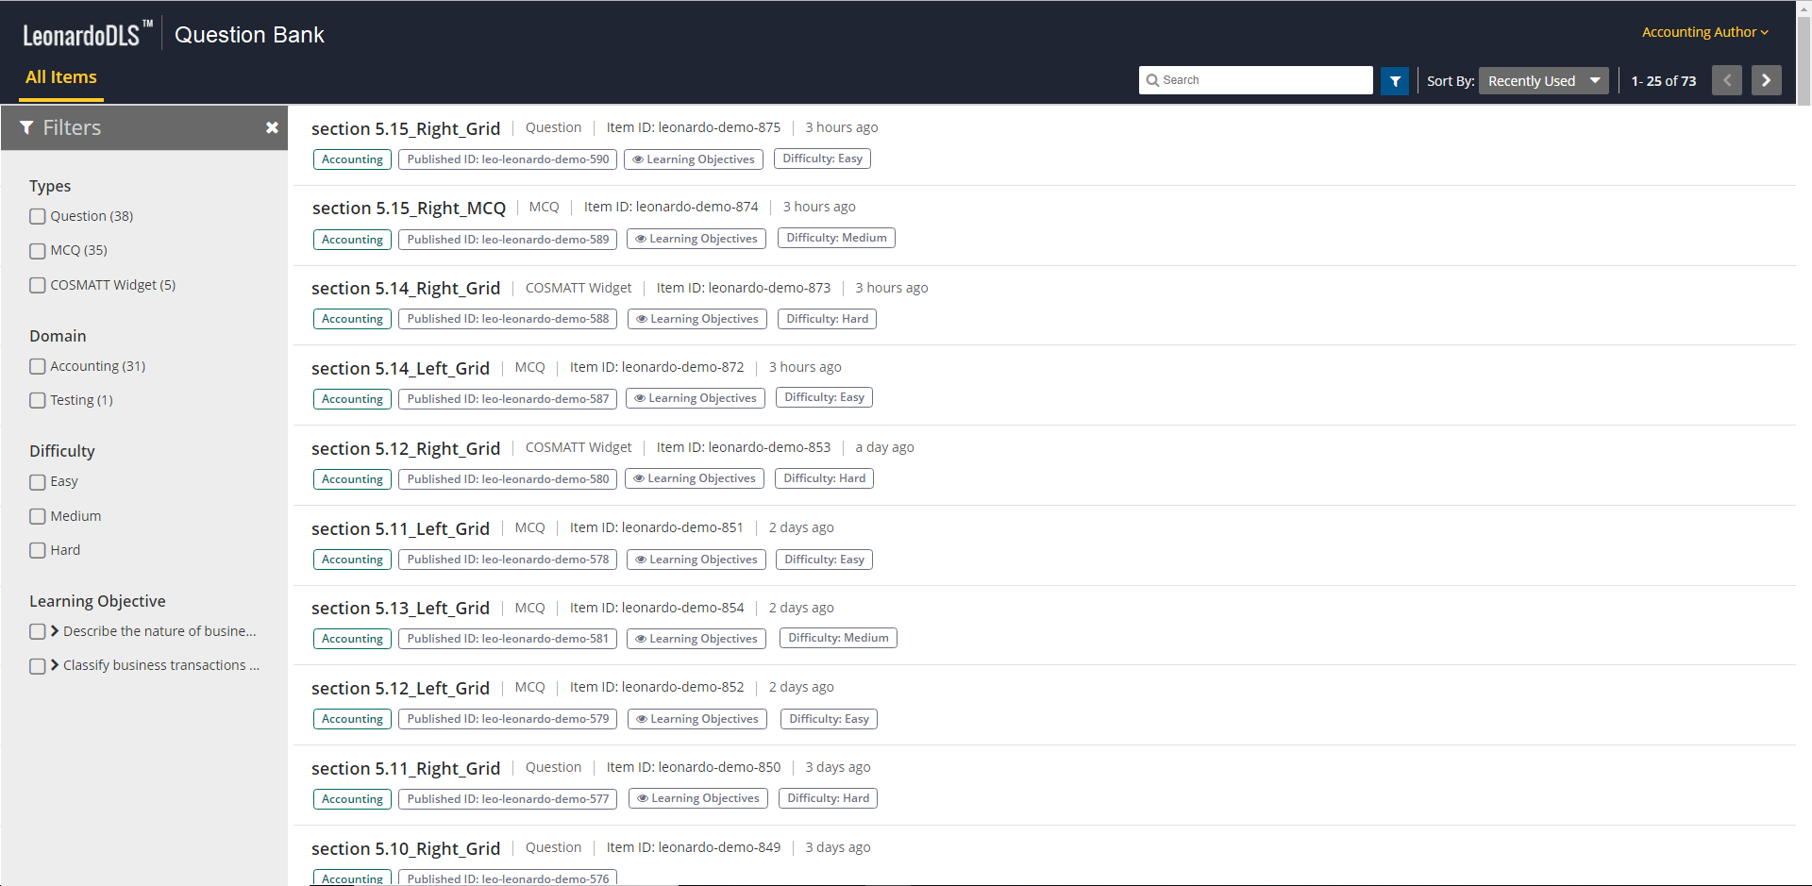
Available Filter for Questions

Slide 11

Filtering Questions On The Basis Of Learning Objectives

Slide 12
Create Assignment Page After Selecting Question From Question Bank
leonardo-item-875

Slide 13
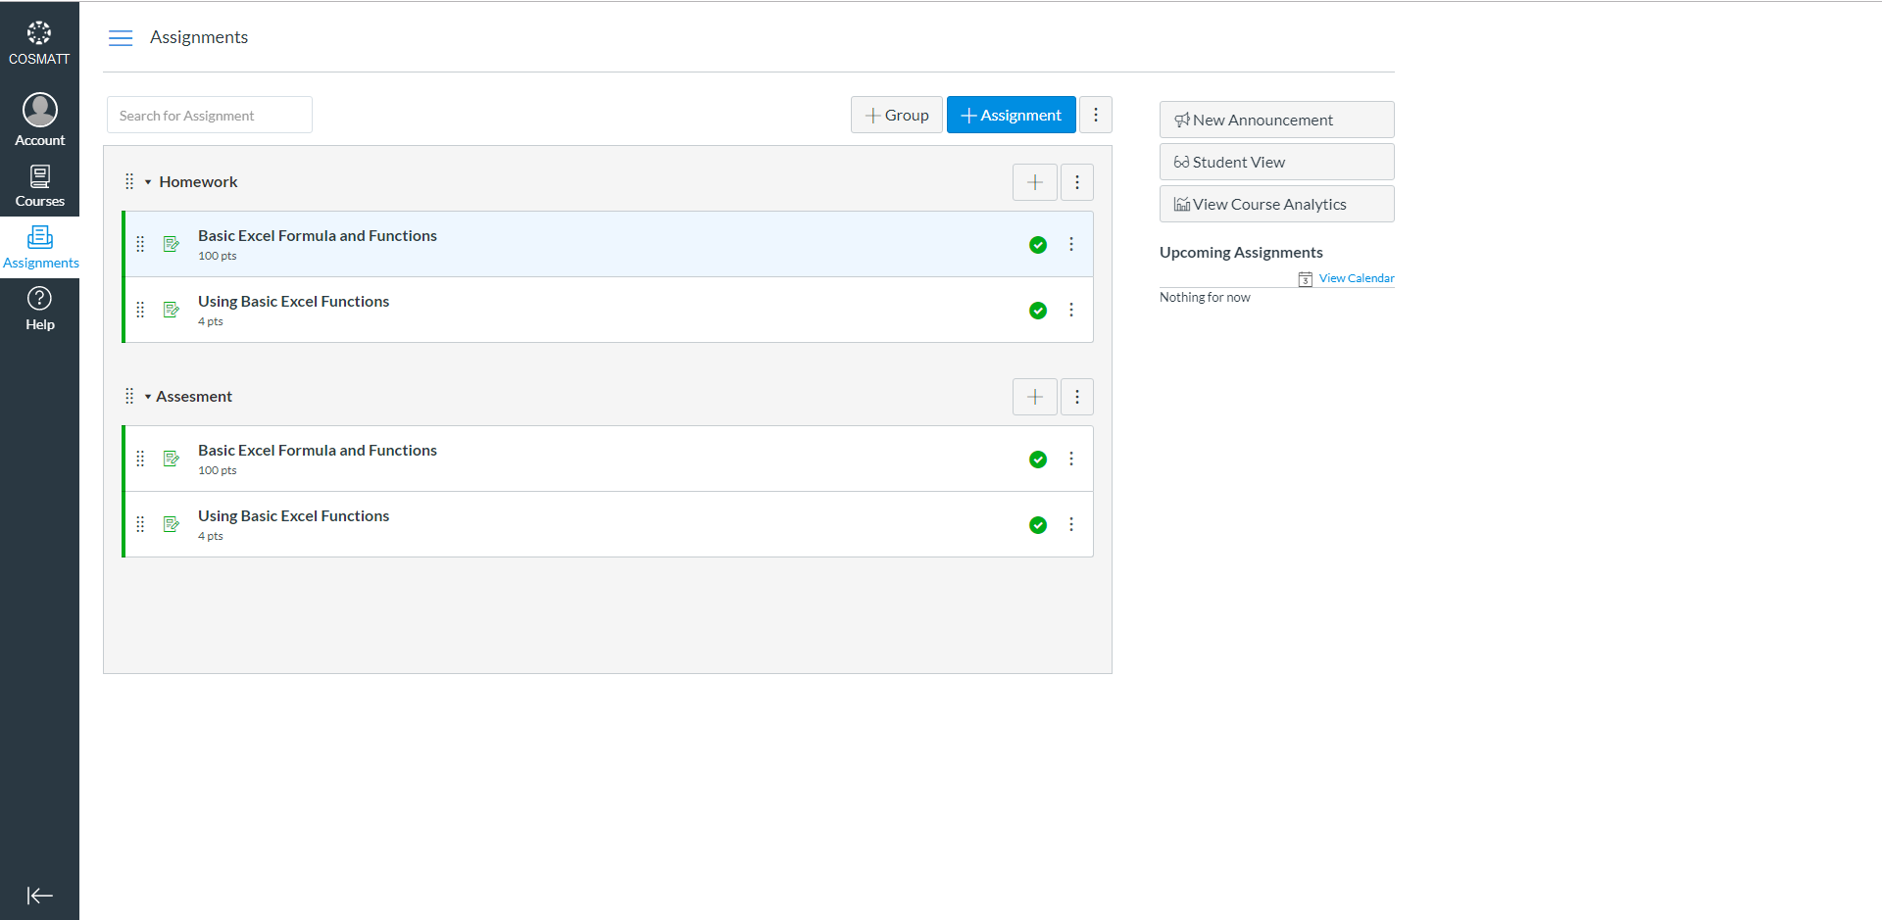
New Assignment Created

